Slide 1
Idea/Approach Details Ministry/ Organization Name: Gov of Uttarakhand Problem Statement : Predicting the trends of quality-oriented jobs Team Name : Trend 365 Team Leader Name : Ajith Pai College Code : 1-3515090586

Slide 2
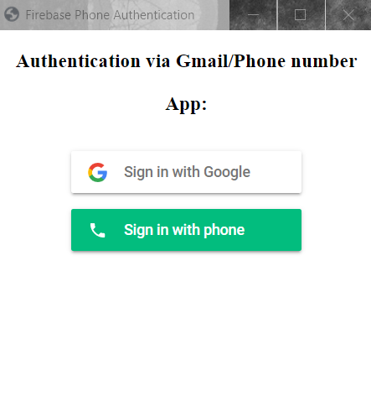
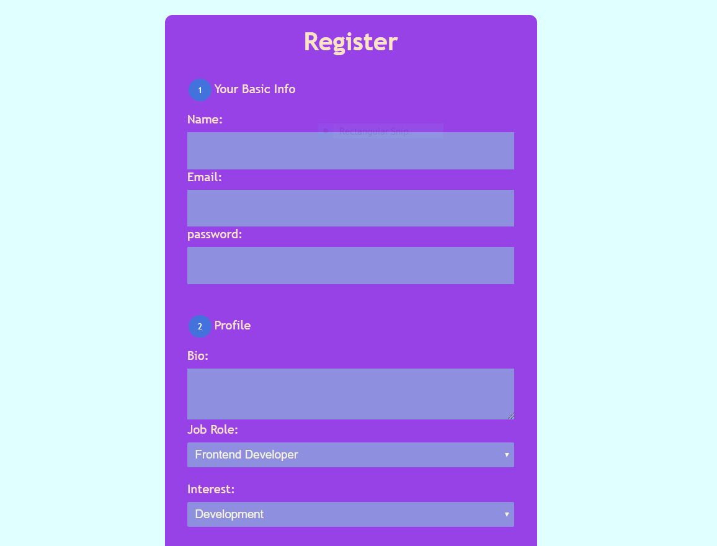
Idea / Approach details
The number of users of Smartphone is growing exponentially and is expected to reach 900 million users by 2022. Providing a Progressive Web Application with an inbuilt ML Algorithm with collaborative filter and Big Data Analytics for the prediction & recommendation of job trends shall maximize the benefit to the Students, Job seekers or Freelancers to analyze
the market trend and required skills. PWA is readily
available to users, just with Internet Connection,
which makes solution available at your fingertips.
The two pictures describe the prototype developed.
HTML, CSS, Nodejs, FireBase hosting, Python, JavaScript, Bootstrap, Big Data Analysis (Clustering), Machine Learning and collaborative filtering (recommendation system), Firestore database.

Slide 3
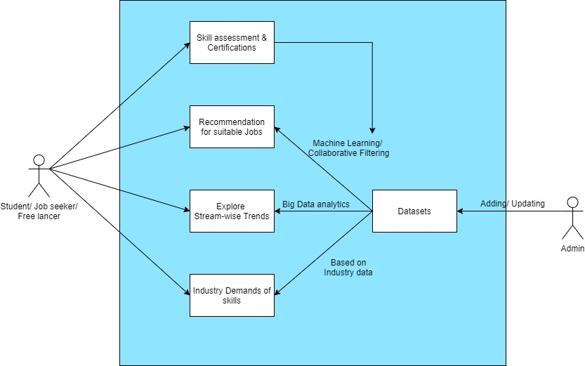
Idea / Approach details
Regular User gets recommendations based on
user skills, market patterns based on locality,
industry, history and can learn about skills
required for the specific Industry .
Admin User can update/add database/model.
Industry experts can log in and give dataset to
Admin who checks the authenticity of the
database and updates the existing dataset.
1.This application depends on updates in the datasets, in order to keep the model up-to-date and trained. The model gets more efficient as the users increase due to Machine-learning.
2.This application requires a use of internet and users to be equipped with smartphones with active location details for localized search results. Making use of minimum requirement and providing maximum benefit.
Notes:
What is a show stopper??

